Slide 1
Notes on Lecture 1&2

Slide 2
Runtime Sorting Example
Sort1()
  T1(n) ≈ n²/2 → T1(n)=c₁ n² → T1(n) = Θ(n²)
Sort2()
  T2(n) = n² → T2(n)=c₂ n² → T2(n) = Θ(n²)
c₁ < c₂ → due to # of steps
T1 < T2 for the same set n

Slide 3
Constants Cost Example
Sort1()
  T1(n) ≈ n²/2 → T1(n)=c₁ n² → T1(n) = Θ(n²)
Sort3()
  T3(n) ≈ n²/2 → T3(n)=c₃ n² → T3(n) = Θ(n²)
c₃ < c₁ → due to step cost
T3 < T2 for the same set n

Slide 4


Insertion Sort
ISERION-SORT() cost times
For j ← 2 to length[A] c₁ n
do key ← A[j] c₂ n-1
» Insert A[j] into the sorted sequence A[1…j-1] 0 n-1
i ← j – 1 c₄ n-1
while i > 0 and A[i] > key c₅
do A[i+1] ← A[i] c₆
i ← i – 1 c₇
A[i+1] ← key c₈ n-1

Slide 5
Best Case: t_{j}=1
T(n) = an +b → Θ( n)
Worst Case: t_{j}=j
T(n) = an²+bn+c → Θ( n²)

Slide 6
The divide-and-conquer approach
Divide the problem into number of subproblem.
Conquer the subproblems by solving them recursively.
Combine the solutions to subproblems into the solution for the original problem.
Merge Sort
Divide: divide the n-element sequences to be sorted into two subsequences of n/2 elements each.
Conquer: sort the two subsequences recursively using merge sort.
Combine: merge the two sorted subsequences to produce the sorted answer.

Slide 7
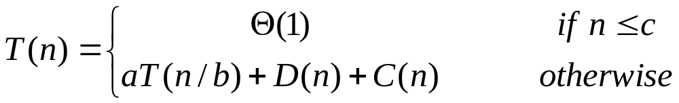
Running Time of Divide-and-Conquer
Recurrence equation

Slide 8
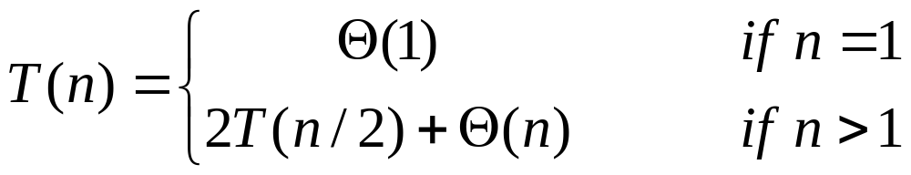
Running Time of Merge-Sort
One way to solve the recurrence of Merge-Sort is:
recursion-tree method which lead to:
T(n) = Θ( n lg n )

Slide 9



Θ, Ω, O Notations
For any two functions g(n) and f(n),
f(n) = Θ(g(n)) iff
f(n) = O(g(n)) and f(n) = Ω(g(n)).

Slide 10
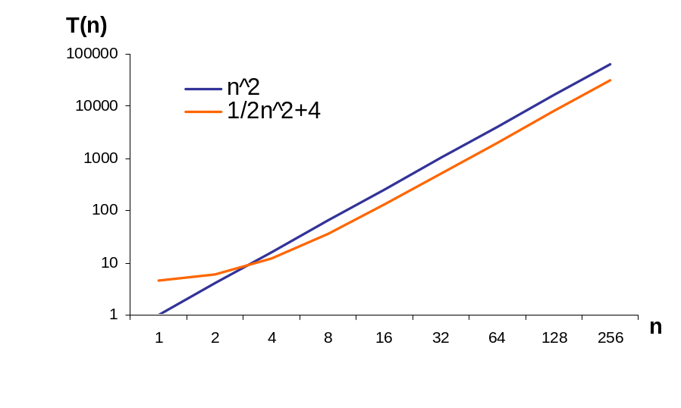
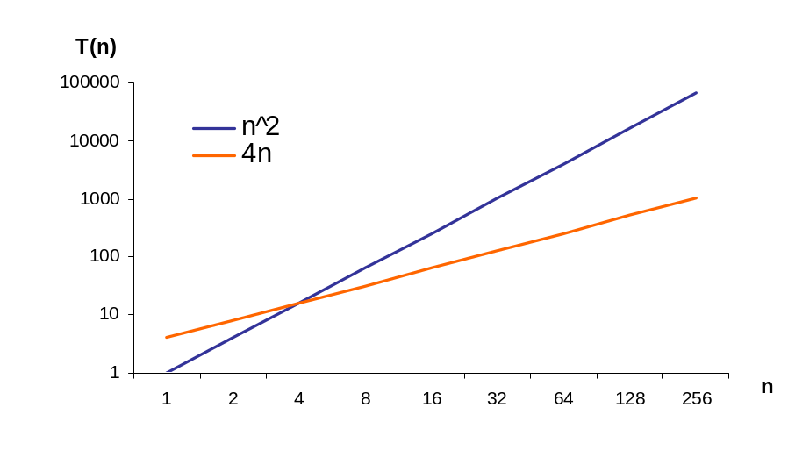
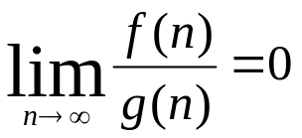
O & o Notations
f1(n) = ½ n²+4
g(n) = n²
f2(n) = 4n
g(n) = n²
f1(n) = O(g(n))
g(n) is asymptotically tight upper bound for f(n)
f2(n) = o(g(n))
g(n) is asymptotically upper bound for f(n)

Slide 11
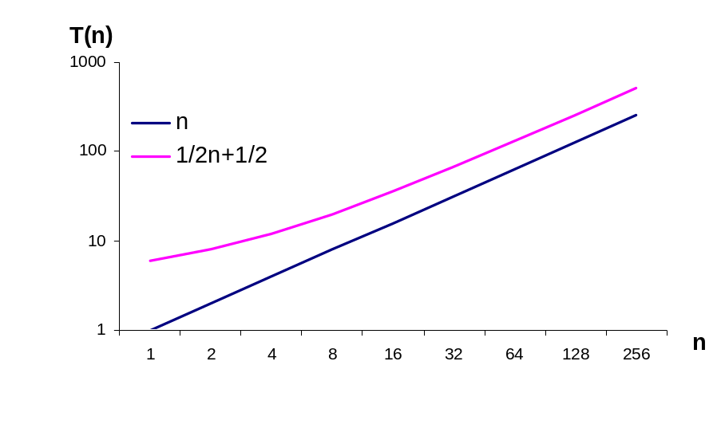
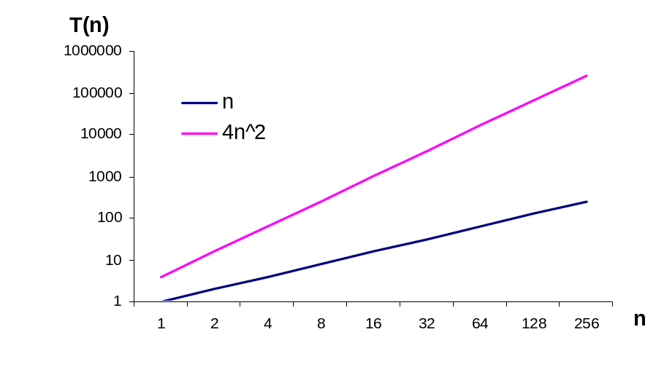
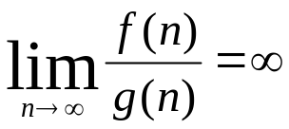
Ω &ω Notations
f1(n) = 2n + 4
g(n) = n
f2(n) = 4n²
g(n) = n
f1(n) = Ω(g(n))
g(n) is asymptotically tight lower bound for f(n)
f2(n) = ω(g(n))
g(n) is asymptotically lower bound for f(n)

Slide 12
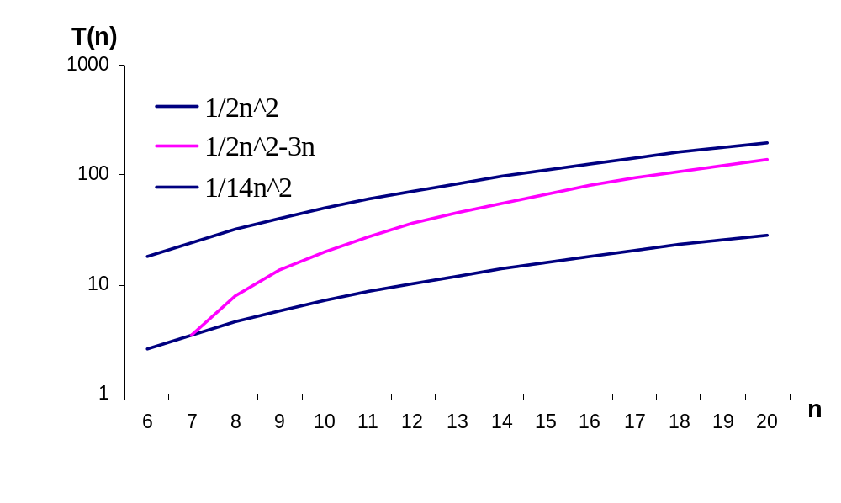
Θ-Notation
f(n) = 1/2n² - 3n g(n) = n²
f(n) = O(g(n)) & f(n) = Ω(g(n)) → f(n) = Θ(g(n))
g(n) is asymptotically tight bound for f(n)

